Slide 1
Database Management System
Lecture # 7-8

Slide 2





Example: University Database
External Schema (View 1 ):
External Schema (View 2):
Course_info(cid:string,cname:string)
student_info(cid:string, name:string)
Students(sid: string
name: string, login: string, age: integer)
Courses(cid: string,
cname:string,
credits:integer)
Enrolled(Eid:string,
cid:string, grade:string)
Relations stored as unordered files.
Index on first column of Students.
Conceptual schema:
Physical schema:

Slide 3


Example: Employee database
External view 1 (C++)
DCL 1 EMPP,
2 EMP# CHAR(6)
2 SAL FIXEDBIN(31)
External view 2 (COBOL)
01 EMPC.
02 EMPNO PIC X(6).
02 DEPTNO PIC X(4).
Conceptual
EMPLOYEE
EMPLOYEE_NUMBER CHARACTER(6)
DEPARTMENT_NUMBER CHARACTER(6)
SALARY DECIMAL(5)
Internal STORED_EMP BYTES=20
PREFIX EMP# DEPT# PAY
BYTE=6 , OFFSET=0
BYTE=6, OFFSET=6, INDEX=EMPX BYTES=4, OFFSET=12
BYTES= 4, ALIGN= FULLWORD,OFFSET=16

Slide 4





Three Levels of Architecture
Syntax Example:
External view 1 External view 2
E_no | F_name | L_name | Age | Salary
Empl_No | L_name | B_no
Conceptual level
Empl_No | F_name | L_name | DOB | Salary | Branch_No
struct EMPLOYEE { int Empl_No;
int Branch_No;
char F_name [15];
char L_name [15];
struct date Date_of_Birth; float Salary;
struct EMPLOYEE *next;
Internal level
//pointer to next employee record
}; index Empl_No; index Branch_No; //define indexes for employees

Slide 5
Advantages Database Schema
You can manage data independent of the physical storage
Faster Migration to new graphical environments
DBMS Architecture allows you to make changes on the presentation level without affecting the other two layers
As each tier is separate, it is possible to use different sets of developers
It is more secure as the client doesn't have direct access to the database business logic
In case of the failure of the one-tier no data loss as you are always secure by accessing the other tier

Slide 6
Disadvantages Database Schema
Complete DB Schema is a complex structure which is difficult to understand for every one
Difficult to set up and maintain
The physical separation of the tiers can affect the performance of the Database

Slide 7
Three Level Architecture Objectives
Each user should be able to access the same data but have a different customize view of the data.
User should not have to deal directly with physical database storage detail.
The DBA should be able to change the database storage structure without affecting the users views.

Slide 8
Three Level Architecture Objectives
The internal structure of the database should be unaffected by changes to the physical aspects of storage.
The DBA should be able to change the conceptual structure of the database without affecting all users.

Slide 9
Data Independence
Data independence is the capacity to change the schema at one level without having to change the schema at the next higher level
There are two kinds:
Logical data independence
Physical data independence

Slide 10
Data Independence
Logical data independence
The ability to modify the conceptual scheme without causing application programs to be rewritten.
The change would be absorbed by the mapping between the external and conceptual levels.
Examples
Adding a new file/index etc.
Adding a new field in a file
Changing type/size
Deleting an attribute

Slide 11
Data Independence
Physical data independence
The ability to modify the internal scheme without having to change the conceptual or external schemas.
Modifications at this level are usually to improve performance.
Example
Changing file organization
Index implementation, hash, tree etc.
Changing storage medium

Slide 12
Database Languages
Data Definition Language (DDL):
Used to define schemas.
Data Manipulation Language (DML):
Used to retrieve, insert, delete, and modify data.
Structured Query Language (SQL):
A comprehensive language that combines both DDL and DML.

Slide 13
SQL Commands
Structured Query Language(SQL) as we all know is the database language by the use of which we can perform certain operations on the existing database and also we can use this language to create a database.
SQL uses certain commands like Create, Drop, Insert etc. to carry out the required tasks.
These SQL commands are mainly categorized into four/five categories

Slide 14
SQL Commands
DDL – Data Definition Language
DQl – Data Query Language
DML – Data Manipulation Language
DCL – Data Control Language
TCL(transaction Control Language)

Slide 15
SQL Commands
DDL (Data Definition Language) : DDL or Data Definition Language actually consists of the SQL commands that can be used to define the database schema.
It simply deals with descriptions of the database schema and is used to create and modify the structure of database objects in the database.

Slide 16
SQL Commands
Examples of DDL commands:
CREATE – is used to create the database or its objects (like table, index, function, views, store procedure and triggers).
DROP – is used to delete objects from the database.
ALTER-is used to alter the structure of the database.
TRUNCATE–is used to remove all records from a table, including all spaces allocated for the records are removed.
COMMENT –is used to add comments to the data dictionary.
RENAME –is used to rename an object existing in the database.

Slide 17
SQL Commands
DQL (Data Query Language) :
DML statements are used for performing queries on the data within schema objects. The purpose of DQL Command is to get some schema relation based on the query passed to it.
Example of DQL:
SELECT – is used to retrieve data from the a database.

Slide 18
SQL Commands
DML(Data Manipulation Language) : The SQL commands that deals with the manipulation of data present in the database belong to DML or Data Manipulation Language and this includes most of the SQL statements.
Examples of DML:
INSERT – is used to insert data into a table.
UPDATE – is used to update existing data within a table.
DELETE – is used to delete records from a database table.

Slide 19
SQL Commands
DCL(Data Control Language) : DCL includes commands such as GRANT and REVOKE which mainly deals with the rights, permissions and other controls of the database system.
Examples of DCL commands:
GRANT-gives user’s access privileges to database.
REVOKE-withdraw user’s access privileges given by using the GRANT command.

Slide 20
SQL Commands
TCL(transaction Control Language) : TCL commands deals with the transaction within the database.
COMMIT - The COMMIT command is the transactional command used to save changes invoked by a transaction to the database.
ROLLBACK - rollback a transaction in case of any error occurs
SAVEPOINT - to rollback the transaction making points within groups
SET TRANSACTION - specify characteristics of the transaction

Slide 21
DBMS Component Modules
The figure showed in next slide is divide into two halves.
The top half refers to the various users of the database system
The lower half shows the internals of the DBMS responsible for storage of data and processing of transactions

Slide 22
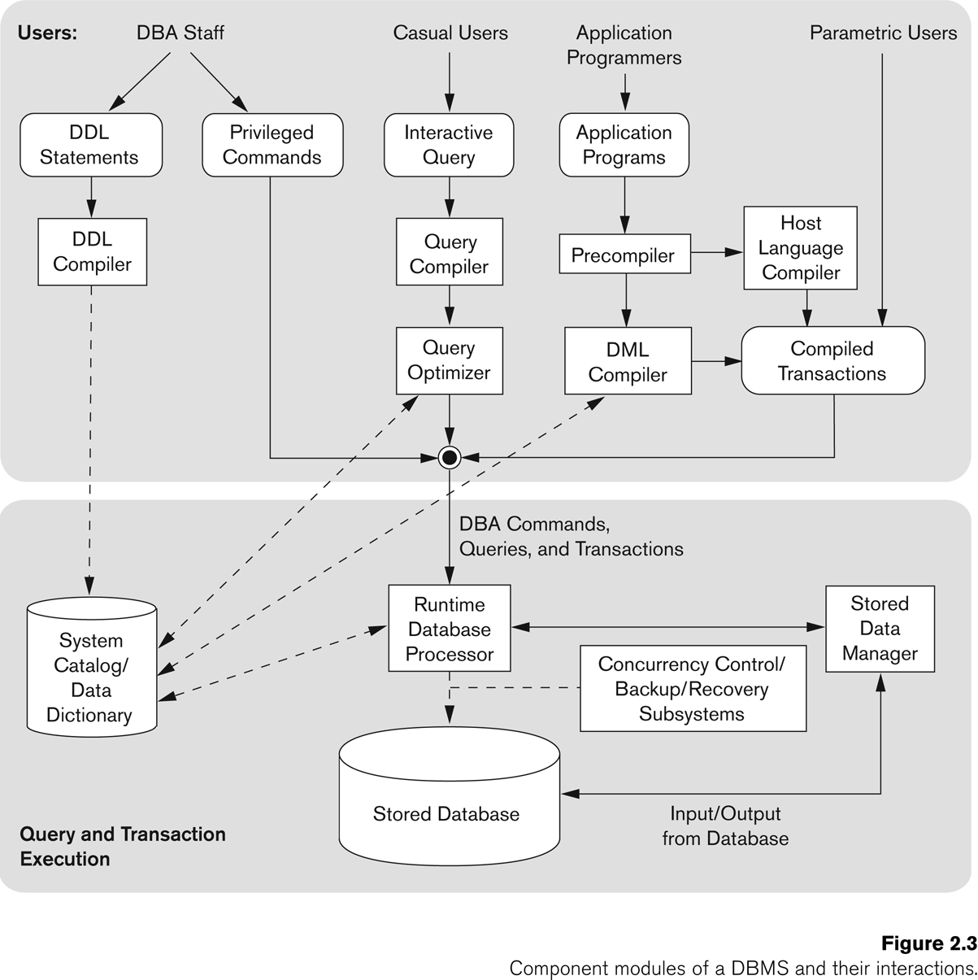
Typical DBMS Component Modules
Users of the database system
Internals of the DBMS

Slide 23
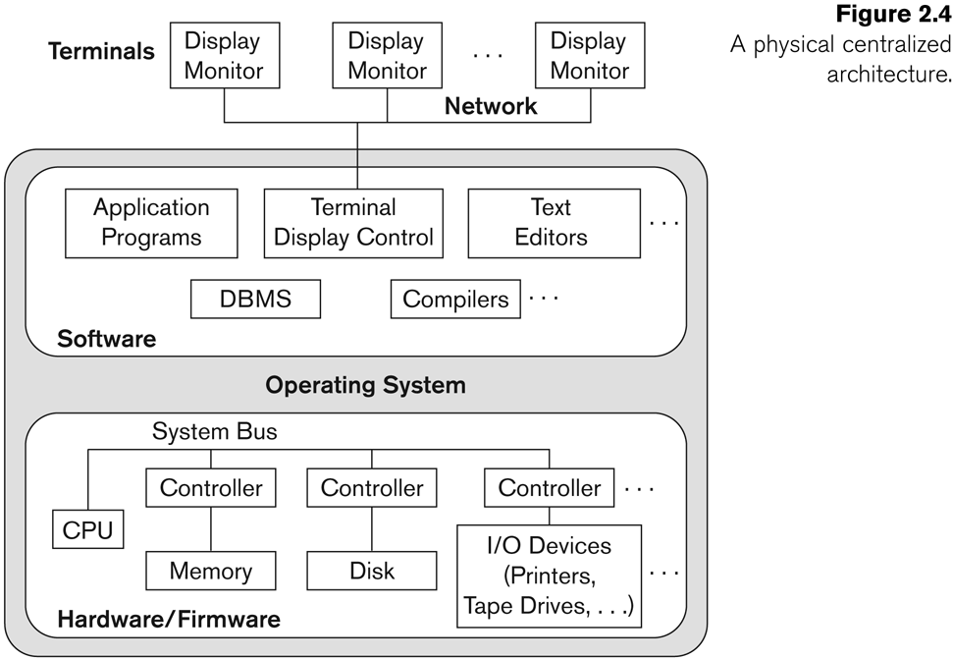
Centralized and Client/Server Architectures for DBMSs
Centralized DBMSs Architecture
All DBMS functionality, application program execution, and user interface processing carried out on one machine

Slide 24
Basic Client/Server Architectures
The client/server architecture was developed to deal with computer environment in which a large number of PCs, workstation, file server…
A client in this framework is typically a user machine that provides user interface capabilities and local processing
A server is a system containing both hardware and software that can provide services to the client machines.

Slide 25
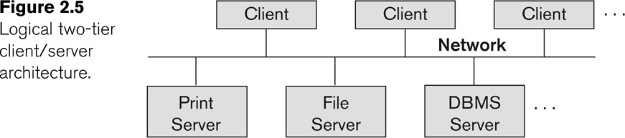
Logical two-tier client server architecture

Slide 26
Two-tier Architecture
This is called two-tire architectures because the software components are distributed over two systems: client and server
The emergence of the Web changed the roles of client and server, leading to the three-tier architecture

Slide 27
Three-tier Architecture
The intermediate layer or middle layer is sometimes called the application server or Web server
Three-tier Architecture Can Enhance Security:
Database server only accessible via middle tier
Clients cannot directly access database server

Slide 28
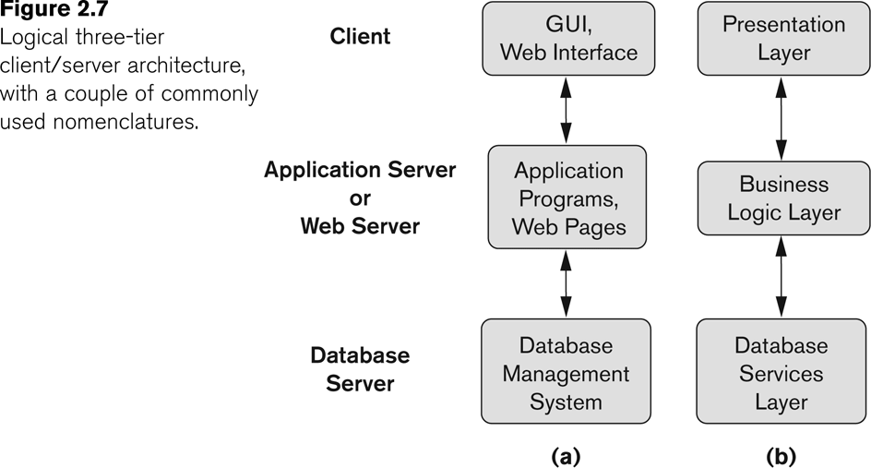
Three-tier Client-Server Architecture

Slide 29
Three-tier architecture
The presentation layer displays information to the user.
The business logic layer handles intermediate rules and constrains before data is passed up to the user or down to the DBMS
If the bottom layer is split into two layers (a web server and a database server), then it is a 4-tire architecture (possible to the n-tier)

Slide 30
Thanks

